Slide 1
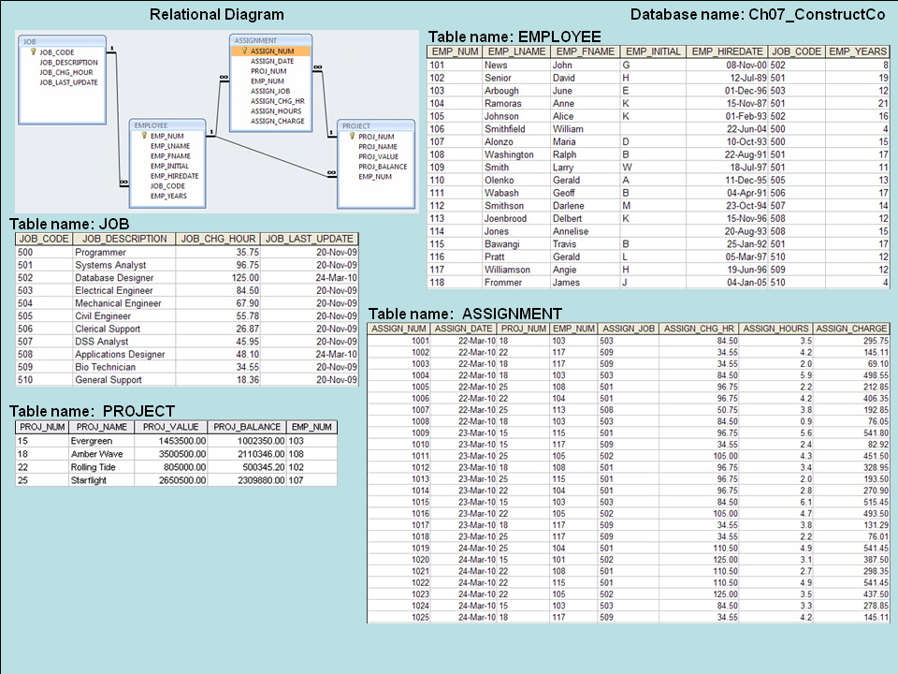

Slide 2
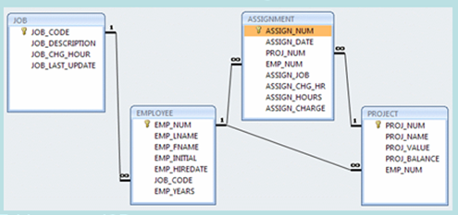
Q1.
Write the SQL code to find the average employee years in the EMPLOYEE table.
SELECT AVG(EMP_YEARS)
FROM EMPLOYEE;

Slide 3
Q2.
Write the SQL code to calculate the ASSIGN_CHARGE values in the ASSIGNMENT table.
(ASSIGN_CHARGE is a derived attribute that is calculated by multiplying ASSIGN_CHG_HR by ASSIGN_HOURS)
UPDATE ASSIGNMENT
SET ASSIGN_CHARGE = ASSIGN_CHG_HR * ASSIGN_HOURS

Slide 4
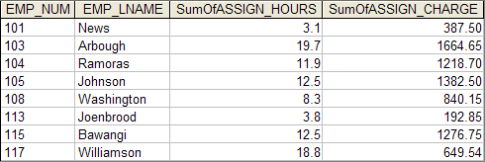
Q3.
SELECT ASSIGNMENT.EMP_NUM, EMPLOYEE.EMP_LNAME,
Sum(ASSIGNMENT.ASSIGN_HOURS) AS SumOfASSIGN_HOURS,
Sum(ASSIGNMENT.ASSIGN_CHARGE) AS SumOfASSIGN_CHARGE
FROM EMPLOYEE, ASSIGNMENT
WHERE EMPLOYEE.EMP_NUM = ASSIGNMENT.EMP_NUM
GROUP BY ASSIGNMENT.EMP_NUM, EMPLOYEE.EMP_LNAME;

Slide 5

Q4.
SELECT ASSIGNMENT.PROJ_NUM,
Sum(ASSIGNMENT.ASSIGN_HOURS) AS SumOfASSIGN_HOURS,
Sum(ASSIGNMENT.ASSIGN_CHARGE) AS SumOfASSIGN_CHARGE
FROM ASSIGNMENT
GROUP BY ASSIGNMENT.PROJ_NUM;

Slide 6
Q4-1.
←Q4
SELECT
Sum(SumOfASSIGN_HOURS) AS SumOfSumOfASSIGN_HOURS,
Sum(SumOfASSIGN_CHARGE) AS SumOfSumOfASSIGN_CHARGE
FROM Q4;

Slide 7
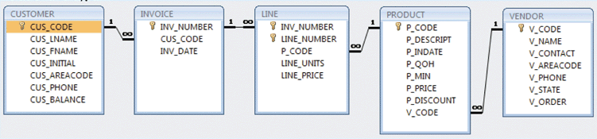
Q5.
Write a query to count the number of invoices.
SELECT COUNT(*)
FROM INVOICE;

Slide 8
Q6.
Write a query to count the number of customers with a customer balance over $500.
SELECT COUNT(*)
FROM CUSTOMER
WHERE CUS_BALANCE>500;

Slide 9
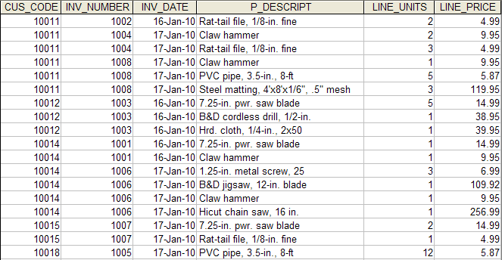
Q7.
Generate the list of customer purchases
SELECT I.CUS_CODE, I.INV_NUMBER, I.INV_DATE, …
FROM INVOICE AS I, LINE AS L, PRODUCT AS P
WHERE I.INV_NUMBER=L.INV_NUMBER
AND L.P_CODE=P.P_CODE
ORDER BY I.CUS_CODE, I.INV_NUMVER, P.P_DESCRIPT;

Slide 10
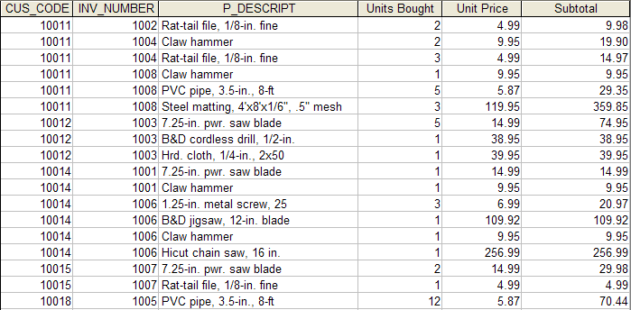
Q8.
Generate the summary of customer purchases with subtotals
SELECT INVOICE.CUS_CODE, INVOICE.INV_NUMBER, PRODUCT.P_DESCRIPT,
LINE.LINE_UNITS AS ‘Units Bought’, LINE.LINE_PRICE AS ‘Unit Price’,
LINE.LINE_UNITS*LINE.LINE_PRICE AS Subtotal
FROM INVOICE, LINE, PRODUCT
WHERE INVOICE.INV_NUMBER = LINE.INV_NUMBER
AND PRODUCT.P_CODE = LINE.P_CODE
ORDER BY INVOICE.CUS_CODE, INVOICE.INV_NUMBER, PRODUCT.P_DESCRIPT;

Slide 11
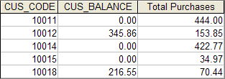
Q9.
SELECT INVOICE.CUS_CODE, CUSTOMER.CUS_BALANCE,
SUM(LINE.LINE_UNITS*LINE.LINE_PRICE) AS ‘Total Purchases’
FROM CUSTOMER, INVOICE, LINE
WHERE INVOICE.INV_NUMBER = LINE.INV_NUMBER
AND CUSTOMER.CUS_CODE=INVOICE.CUS_CODE
GROUP BY INVOICE.CUS_CODE, CUSTOMER.CUS_BALANCE;

Slide 12
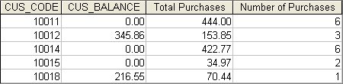
Q10.
SELECT INVOICE.CUS_CODE, CUSTOMER.CUS_BALANCE,
SUM(LINE.LINE_UNITS*LINE.LINE_PRICE) AS ‘Total Purchases’
COUNT(*) AS ‘Number of Purchases’
FROM CUSTOMER, INVOICE, LINE
WHERE INVOICE.INV_NUMBER = LINE.INV_NUMBER
AND CUSTOMER.CUS_CODE=INVOICE.CUS_CODE
GROUP BY INVOICE.CUS_CODE, CUSTOMER.CUS_BALANCE;

Slide 13
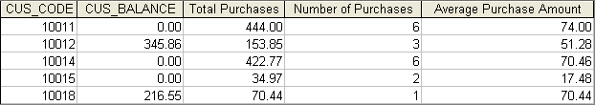
Q11.
SELECT INVOICE.CUS_CODE, CUSTOMER.CUS_BALANCE,
SUM(LINE.LINE_UNITS*LINE.LINE_PRICE) AS ‘Total Purchases’
COUNT(*) AS ‘Number of Purchases’
AVG(LINE.LINE_UNITS*LINE.LINE_PRICE) AS ‘Average Purchase Amnt’
FROM CUSTOMER, INVOICE, LINE
WHERE INVOICE.INV_NUMBER = LINE.INV_NUMBER
AND CUSTOMER.CUS_CODE=INVOICE.CUS_CODE
GROUP BY INVOICE.CUS_CODE, CUSTOMER.CUS_BALANCE;

Slide 14
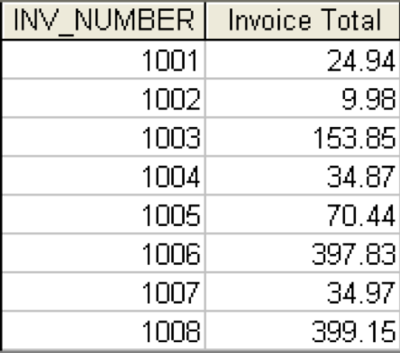
Q12.
SELECT LINE.INV_NUMBER,
SUM(LINE.LINE_UNITS*LINE.LINE_PRICE) AS ‘Invoice Total’
FROM LINE
GROUP BY LINE.INV_NUMBER;

Slide 15
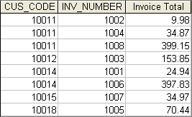
Q13.
SELECT CUS_CODE, LINE.INV_NUMBER,
SUM(LINE.LINE_UNITS*LINE.LINE_PRICE) AS ‘Invoice Total’
FROM INVOICE, LINE
WHERE INVOICE.INV_NUMBER=LINE.INV_NUMBER
GROUP BY CUS_CODE, LINE.INV_NUMBER;

Slide 16
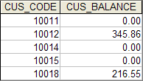
Q14.
Balances for customers who made purchases
SELECT CUS_CODE, CUS_BALANCE
FROM CUSTOMER
WHERE CUSTOMER.CUS_CODE IN
(SELECT DISTINCT CUS_CODE
FROM INVOICE);
SELECT DISTINCT CUS_CODE, CUS_BALANCE
FROM CUSTOMER, INVOICE
WHERE CUSTOMER.CUS_CODE =INVOICE.CUS_CODE

Slide 17

Q14-1
Q14
SELECT MIN(CUS_BALANCE) AS ‘Minimum Balance’,
MAX(CUS_BALANCE) AS ‘Maximum Balance’,
AVG(CUS_BALANCE) AS ‘Average Balance’
FROM Q14

Slide 18
Q15.
SELECT SUM(CUS_BALANCE) AS ‘Total Balance’
MIN(CUS_BALANCE) AS ‘Minimum Balance’
MAX(CUS_BALANCE) AS ‘Maximum Balance’
AVG(CUS_BALANCE) AS ‘Average Balance’
FROM CUSTOMER

Slide 19

Q16.
List customers who did not make purchases
SELECT CUS_CODE, CUS_BALANCE
FROM CUSTOMER
WHERE CUSTOMER.CUS_CODE NOT IN
( );
SELECT DISTINCT CUS_CODE FROM INVOICE

